Slide 1
Minutes
10th meeting of dqac chairman and coordinatorS with Hon’ble VC
05.04.2018

Slide 2
The Steering Committee - Role
Will be responsible to monitor progress of all the tasks required for NAAC Assessment and Accreditation 2019 on day to day basis till end of the assessment
Prepare time line and action plan for NAAC Assessment and Accreditation 2019
Continuously monitor the progress of the criteria wise and will sort out issues, if any
Report to Hon’ble Vice Chancellor on the short comings, if any and will prepare action plan to meet out them within stipulated time period

Slide 3
Criteria Wise Committees - Role
Committees formed based on 7 criterias of NAAC
These committees will work in coordination and communication with steering committee
Committees will regularly meet and prepare action plan and complete Self Study Report (SSR) based on Qualitative and Quantitative Matrices within stipulated time period
Committees will collect and compile data required for various departments and offices as per the desired format

Slide 4
Important Dates
Department wise Data filling from - 15th April 2018
Last date to fill – 30th May 2018
Department Wise Visits – Last week of June 2018
External Academic and Administrative Audit – July 2018
Data Filling for New Session - 01 Sep – 08 Sep 2018
Mock Peer Team Visit – October 2018

Slide 5
Type of Documents/Files required to be ready
Ordinances/Statues
Letters/Circulars/Notices/ Office Orders
Note sheets
Print of Emails
Minutes of Meetings (Signed)
Posters/ Brochures/ Magazines/ Booklets/ Leaflets
Photographs/ Images / Audio Files / Video Files
Log Files
Attendance Registers
Media Reports (News Paper Cuttings)
Please keep all documents ready.
Refer NAAC Manual as attached again.

Slide 6
Status
Valid till 20.02.2019

Slide 7
NAAC’s Revised Accreditation Framework (RAF)
- Launched in July 2017
- Pre-qualifier for peer team visit, as 30% of System Generated Score
- System Generated Scores (SGS) - Combination of:
Online Evaluation (about 70%) and
Peer Judgement (about 30%)
- Element of third party validation of data (DVV)

Slide 8
NAAC’s quality concerns through self-evaluation
Self Study Report (SSR) to be submitted to NAAC needs involvement of all the stakeholders
Management
Faculty Members
Administrative Staff
Students
Parents
Employers, Community and Alumni

Slide 9
THE ASSESSMENT PROCESS
Will be carried out in three stages -
Self Study Report (SSR)
Student Satisfaction Survey and
Peer Team Report
SSR has two kinds of Metrics:
Quantitative Metrics (Q_{n}M) - Requiring quantifiable facts and figures as data
Qualitative Metrics (Q_{l}M) - Requiring descriptive responses

Slide 10
Where is the change?
S No | Old Norms | RAF
01 | Submission of SSR in hard copies | On-line submission of SSR (No hard copies) PTV members will get e-mail with pdf file as attachment.View the link file at institution website.
02 | Evaluative Report of Department for the colleges | No Evaluative Report of Department for the Colleges
03 | No Data Validation and Verification (DVV) | Third party data validation and verification (DVV)

Slide 11
Where is the change?
S No | Old Norms | RAF
04 | Student feedback taken at institution level | On line Student Satisfaction Survey (S3) from NAAC
05 | No Grade qualifier | Grade qualifier – A, B, C
06 | No penalty Provision | Penalty Clauses on fraudulent data
Grade Qualifiers for HEI’s
A grade qualifier is prepared for the institution to qualify for valid accreditation. In order to qualify for any Grade (C to A++) institution needs to score at least 1.51 CGPA aggregated score (quantitative and qualitative) in each criterion.

Slide 12
Important Numbers
Criteria – Dimensions encompassing academic, administrative and management activities of the Institution
# 7
Key Aspects (KA/KI) – Specific functional aspects within criteria
# 34
Quality Indicators (Qis/Metric) – Actual tasks or operations carried out
# 137

Slide 13
Page 23 of Manual

Slide 14
Seven Criteria Framework for Assessment (Earlier)
Curricular Aspects
Teaching-learning and Evaluation
Research, Consultancy and Extension
Infrastructure and Learning Resources
Student Support and Progression
Governance, Leadership and Management
Innovations and Best Practices

Slide 15
Seven Criteria Framework for Assessment (QIF)
Curricular Aspects
Teaching-learning and Evaluation
Research, Innovations and Extension
Infrastructure and Learning Resources
Student Support and Progression
Governance, Leadership and Management
Institutional Values and Best Practices

Slide 20
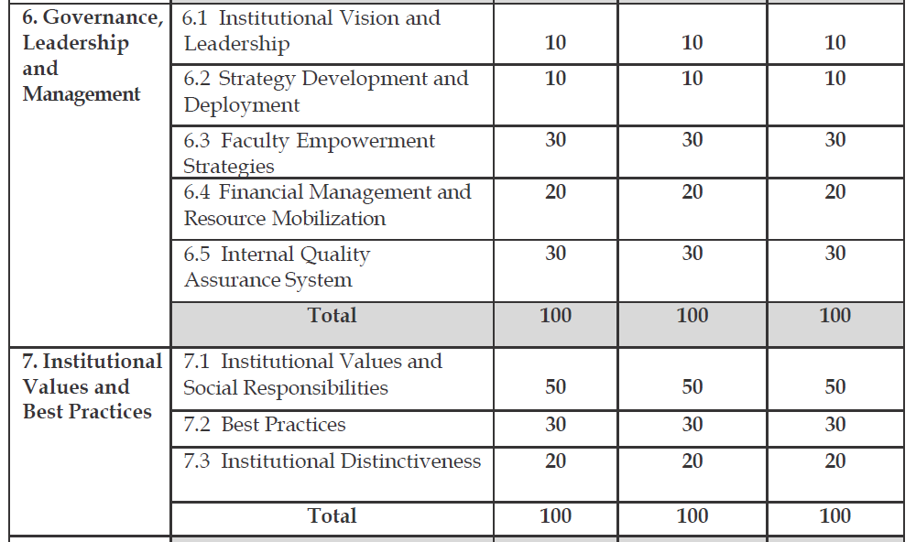

Slide 21
Key Indicators – New Introduced
Teacher Profile and Quality (2.4)
Student Satisfaction Survey (2.7)
Innovation Ecosystem (3.3)
Alumni Engagement (5.4)
Institutional Values and Social Responsibilities (7.1)
Institutional Distinctiveness (7.3)

Slide 22
Student Satisfaction Survey
1. SSS will be administered to institutions which qualify for the Peer Team Visit.
2. Institutions will have to submit the entire database of students with e-mail/mobile numbers.
3. The SSS questionnaire (20 objective & 01 subjective) will be e-mailed to all students and the following rule will be applied for processing the responses.
Responses should be received from at least 10% of the student population or 500, whichever is lesser.
4. If the response rate is lower than the limits mentioned by NAAC, the metric will not be taken up for evaluation.
5. SSS will be completed before Peer Team Visit.

Slide 23
SSR
Quantitative Questions
• 5 year 2 stage(Formula based)
• 5 year block question(Formula based)
• Quantitative questions asking number (without formula year wise or block period)
• Current year data based
Qualitative Questions (Restriction of 500 words)

Slide 25
Penalty for discrepancies / inconsistent data
in the SSR: DVV level
Data discrepancy may have two origins
Misunderstanding/ambiguity in the interpretation of definition/data of the metric
Discrepancies/inconsistencies in data submission.

Slide 26
Stage II
Edited SSR sent to DVV
DVV Deviation Report
If the institution scores above 30% on QnM the following actions will to be taken on the Deviation Report.
≤10% of the metrics | The DVV value will be construed as final and Peer Team Visit conducted.
>10% and ≤15% of the metrics | A cautionary advice will be issued to the institution. Values of DVV taken as final Debarred from Peer Team Visit till the next window. Forfeit the first instalment of Accreditation Fee
≥15% of the metrics | Forfeit the first instalment of Accreditation Fee Debarred from accreditation for one year. Names of such institutions to be submitted to the Statutory Authorities
If the institution scores below 30%, the Peer Team Visit will not be conducted.

Slide 27
SSR
Page 35 to 144 of Manual

